Slide 1
Java Servlets and JSP

Slide 2
Servlet Technology
JAVA APPLETs run on client side (in web browsers) or writing Internet applications.
JAVA SERVLETs run on server side for web-based application. (No GUI is required)
JAVA have built-in support for multithread.
Servlet API is Standard Java Extension API, (NOT part of core Java) and available as add-on package.
Servlet & JSP

Slide 3
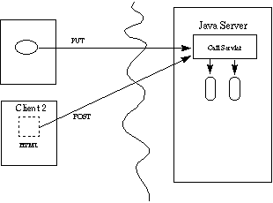
Servlets Overview
Protocol and Platform-independent server side Java components
Clients may range from simple HTML forms to Java applets.
Used as middle tiers for distributed application systems.
Servlet & JSP

Slide 4
What is a java servlet ?
a java servlet is a java class extending HTTPServlet class
a java servlet class implements the doGet(), doPost() or other equivalent HTTP method and (usually) prints at the standard output an html file
a java servlet class can contain any kind of java code the JDK can compile
a java servlet class needs to be compiled prior to using it; it must use servlet-api.jar

Slide 5
Apache Tomcat
the most well known servlet/jsp container
is a web server + implementation of Java Servlet and JSP (Java Server Pages) APIs
is developed by Apache Software Foundation
available at http://tomcat.apache.org/ under Apache Software License

Slide 6
First JSP file
<html>
<body>
<%
out.println(“First JSP… It works<br/>");
%>
</body>
</html>

Slide 7
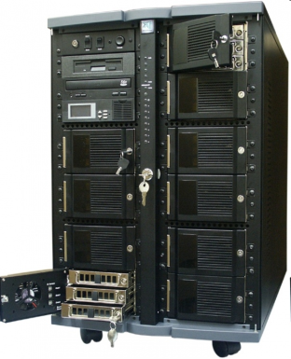
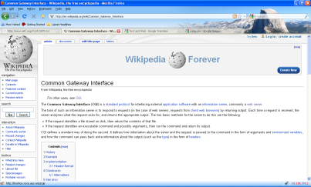
Server-side Java for the web
a servlet is a Java program which outputs an html page; it is a server-side technology
HTTP Request
Server-side Request
Java Servlet
Java Server Page
HTTP Response
Response Header +
Html file
browser
web server
servlet container (engine) - Tomcat

Slide 8
Security.
Rely on HTTP-specific authentication
Secure Socket Layer (SSL)
Java advantage: no memory access violations, strong typing violations. (Servlet will not crash servers.)
Security Manager. Only trusted servlets will be allow to access network services or local files.
Support fine grained access control (more secure than MS. ActiveX.)
Servlet & JSP

Slide 9
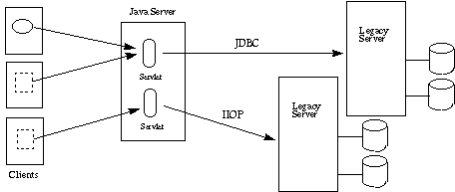
Three Tier Applications.
Servlet & JSP

Slide 10
Sample Servlet
Hello World!
import java.io.*;
import javax.servlet.*;
import javax.servlet.http.*;
public class HelloWorld extends HttpServlet {
public void doGet(HttpServletRequest request, HttpServletResponse response)
throws IOException, ServletException
{
response.setContentType("text/html");
PrintWriter out = response.getWriter();
out.println("<html>");
out.println("<body>");
out.println("<head>");
out.println("<title>Hello World!</title>");
out.println("</head>");
out.println("<body>");
out.println("<h1>Hello World!</h1>");
out.println("</body>");
out.println("</html>");
}
Servlet & JSP

Slide 11
JavaServer Pages VS. Servlets.
Dynamic Page require for.
  Working on any web or application server
  Separating the application logic from the appearance of the page
  Allowing fast development and testing
  Simplifying the process of developing interactive web-based applications
JSP is a new approach to fit this need.
Servlet ,to turn page, have to edit and recompile.
Servlet & JSP

Slide 12
JavaServer Pages Approach.
Separating content generation from presentation
Emphasizing reusable components
Simplifying page development with tags
Java Technology benefits (memory management and security.
Scalability (integrated with J2EE)
Servlet & JSP

Slide 13
JSP Example.
<HTML>
<%@ page language=="java" imports=="com.wombat.JSP.*" %>
<H1>Welcome</H1>
<P>Today is </P>
<jsp:useBean id=="clock" class=="calendar.jspCalendar" />
<UL>
<LI>Day: <%==clock.getDayOfMonth() %>
<LI>Year: <%==clock.getYear() %>
</UL>
<% if (Calendar.getInstance().get(Calendar.AM_PM) ==== Calendar.AM) { %>
Good Morning
<% } else { %>
Good Afternoon
<% } %>
<%@ include file=="copyright.html" %>
</HTML>
Servlet & JSP

Slide 14
JSP components.
JSP Directives
  <%@ …. %>
JSP Tags
  <jsp:useBean … />
  <jsp:setProperty … />
  <jsp:getProperty … />
  <jsp:include … />
  <jsp:forward … />
JSP expression
  <%== … %>
Scripting Elements (scriptlet)
  <% ... %>
Servlet & JSP

Slide 15

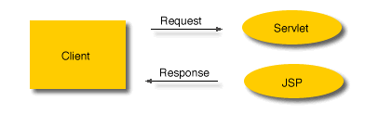
Application Model
Simple Application
Flexible Application with Java Servlets
Servlet & JSP

Slide 16
First java servlet
import java.io.*;
import java.util.*;
import javax.servlet.*;
import javax.servlet.http.*;
public class FirstServlet extends HttpServlet {
public void doGet(HttpServletRequest request, HttpServletResponse response)
throws IOException, ServletException
{
response.setContentType("text/html");
PrintWriter out = response.getWriter();
out.println("<html>");
out.println("<head>");
out.println("<title>First servlet</title>");
out.println("</head>");
out.println("<body>");
out.println("It works...<hr>");
out.println("</body>");
out.println("</html>");
}
}

Slide 17
Tomcat standard folders
bin – contains executable files for controlling the server (start, shut down etc.)
conf – contains configuration files; most important server.xml for configuring the server and web.xml a general configuration file for web applications
lib – libraries (jars) used by tomcat and deployed web applications
logs – log files
temp – temporary files
webapps – contains the web applications deployed
work – contains files created by tomcat during running (e.g. it crates a servlet from each jsp file)

Slide 18
Format of a web application
web applications are stored in the webapps folder, either as a folder or as a .war archive
a web application (either a folder or a .war archive) must contain the following files:
  WEB-INF folder
  WEB-INF\web.xml: a configuration file
optionally the WEB-INF folder can contain the following subfolders:
  classes: which contain servlets
  lib: which contains jars used by the web application
html, jsp and resource files can be placed anywhere in the web application home folder
servlets must be placed in the folder or subfolders of WEB-INF\classes

Slide 19
A very simple web.xml example
<?xml version="1.0" encoding="ISO-8859-1"?>
<web-app xmlns="http://java.sun.com/xml/ns/javaee"
xmlns:xsi="http://www.w3.org/2001/XMLSchema-instance"
xsi:schemaLocation=http://java.sun.com/xml/ns/javaee http://java.sun.com/xml/ns/javaee/web-app_2_5.xsd version="2.5">
</web-app>

Slide 20
Configuring servlets
for JSPs (Java Server Pages) no additional configuration needs to be done
for java servlets additional lines must be placed in the web.xml file:
<servlet>
<servlet-name>ServletsName</servlet-name>
<servlet-class>The_Class_Name_of_the_Servlet</servlet-class>
</servlet>
<servlet-mapping>
<servlet-name> ServletsName </servlet-name>
<url-pattern>/URL_of_the_servlet</url-pattern>
</servlet-mapping>

